Slide 1

Algebra 1
Unit 2, Lesson 1 Applying Product Laws of Exponents to Algebraic Expressions Volume 1, pg. 57

Slide 2


Benchmark
MA.912.NSO.1.2
Generate equivalent algebraic expressions using the properties of exponents.
volume 1, pg. 57

Slide 3
Integrated Mathematical Thinking and Reasoning Standards
MA.K12.MTR.2.1 Demonstrate understanding by representing problems in multiple ways.
MA.K12.MTR.4.1 Engage in discussions that reflect on the mathematical thinking of self and others.
MA.K12.MTR.5.1 Use patterns and structure to help understand and connect mathematical concepts.
volume 1, pg. 57

Slide 4

Learning Target
I can generate equivalent algebraic expressions using the properties (laws) of exponents to find the product of monomial expressions.
volume 1, pg. 57

Slide 5

Warm-Up
volume 1, pg. 57

Slide 6

2.1.1 Warm-Up: Growth Mindset
Write a check mark in the box that best describes how you feel about mistakes.
I do not like to admit I made a mistake.
I think all mistakes are bad.
Mistakes tell me that I won’t ever understand.
Mistakes make me wonder what I am missing.
I think a mistake is a chance to try another strategy.
Mistakes help me learn.
volume 1, pg. 57
Notes:
Video Link: https://algebranation.wistia.com/medias/fi4fidi5y8

Slide 7
Consider the acronym shown.
How does this interpretation compare to your feelings about making mistakes?
Means
I
Start
To
Acquire
Knowledge
Experience
Skills
volume 1, pg. 57
Notes:
Video Link: https://algebranation.wistia.com/medias/fi4fidi5y8

Slide 8

Guided Instruction
volume 1, pg. 58

Slide 9

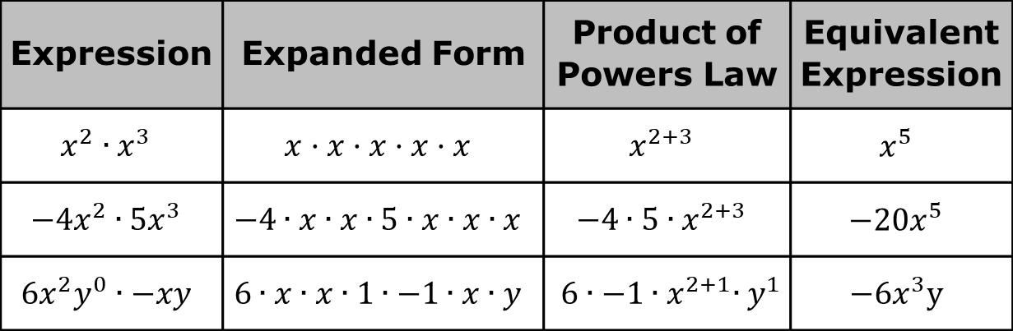
2.1.2 Guided Instruction: Equivalent Algebraic Expressions
The laws of exponents can be applied to generate equivalent algebraic expressions.
The table shows three expressions and two different methods that can be used to determine an equivalent expression.
Expression | Expanded Form | Product of Powers Law | Equivalent Expression
$$x^{2}∙x^{3}$$ | $$x·x·x·x·x$$ | $$x^{2+3}$$ | $$x^{5}$$
$$−4x^{2}∙5x^{3}$$ | $$−4∙x∙x∙5∙x∙x∙x$$ | $$−4∙5{∙x}^{2+3}$$ | $$−20x^{5}$$
$$6x^{2}y^{0}∙−xy$$ | $$6∙x∙x∙1∙−1∙x∙y$$ | $$6∙−1{∙x}^{2+1}{∙y}^{1}$$ | $$−6x^{3}y$$
volume 1, pg. 58

Slide 10
Discuss with your partner any patterns you notice between the expanded form and applying the product of powers law.
Complete the statements.
When multiplying monomial terms, the coefficients
of the terms can be to find the coefficient of the equivalent expression. The product of powers law of exponents can be applied to that are the same.
added
multiplied
bases
coefficients
volume 1, pg. 58

Slide 11

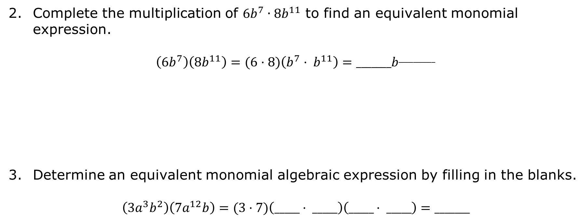
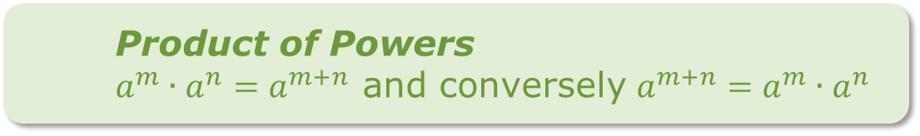
Complete the multiplication of $6b^{7}∙{8b}^{11}$ to find an equivalent monomial expression.
$$\left({6b}^{7}\right)\left({8b}^{11}\right)=(6·8)\left(b^{7}· b^{11}\right)=_______b^{__________}$$
Determine an equivalent monomial algebraic expression by filling in the blanks.
$$\left({3a}^{3}b^{2}\right)\left({7a}^{12}b\right)=(3·7)\left(_____· _____\right)\left(_____· _____\right)=_______$$
Product of Powers
${a^{m}∙a^{n}=a}^{m+n}$ and conversely $a^{m+n}=a^{m}∙a^{n}$
volume 1, pg. 58

Slide 12
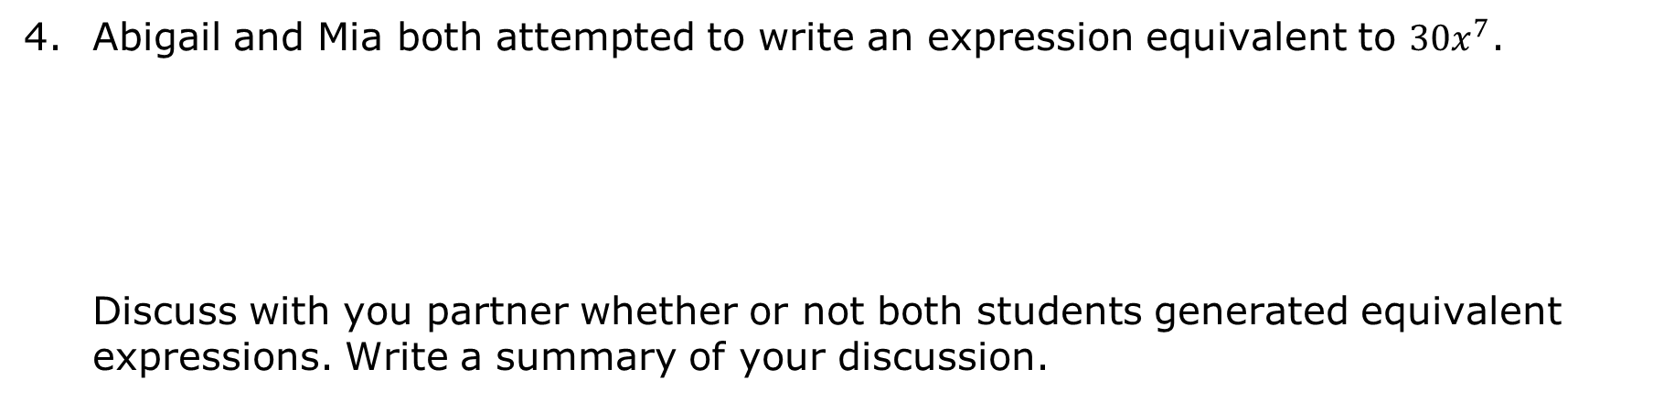
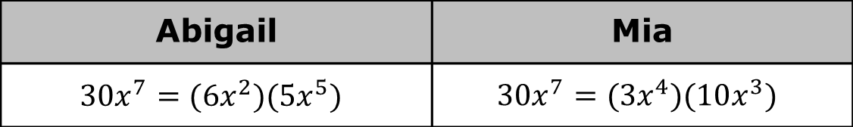
Abigail and Mia both attempted to write an expression equivalent to ${30x}^{7}$.
Discuss with you partner whether or not both students generated equivalent expressions. Write a summary of your discussion.
Abigail | Mia
$${30x}^{7}=(6x^{2})(5x^{5})$$ | $${30x}^{7}=(3x^{4})(10x^{3})$$
volume 1, pg. 58

Slide 13

Guided Practice
volume 1, pg. 59

Slide 14


2.1.3 Guided Practice: Products of Monomials
Generate an equivalent algebraic monomial expression.
a. $(−9t^{0}u^{4})(\frac{1}{3}u^{11})(−10t^{20}u^{8})$
b. $(9q^{−3})(0.6q^{10})(12q^{5})$
c. $(−4x^{0}y^{2})(−10x^{3}y^{5})(1.2x^{4})$
d. $(1.2m^{2}n^{3})(−2.25m^{7})(−0.5n^{12})$
volume 1, pg. 59

Slide 15

Collaboration
volume 1, pg. 59

Slide 16

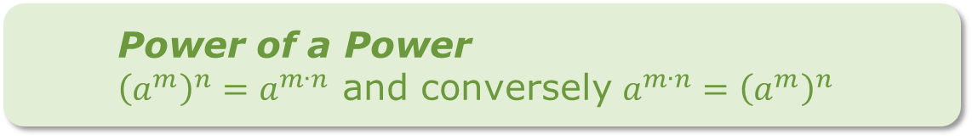
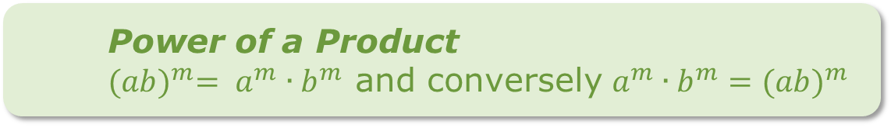
2.1.4 Collaboration: Raising a Monomial to a Power
Additional laws of exponents can be applied to generate equivalent algebraic expressions.
Power of a Product
${(ab)}^{m}= a^{m}∙b^{m}$ and conversely $a^{m}∙b^{m}=({ab)}^{m}$
Power of a Power
${\left(a^{m}\right)}^{n}=a^{m∙n}$ and conversely $a^{m∙n}={\left(a^{m}\right)}^{n}$
volume 1, pg. 59

Slide 17
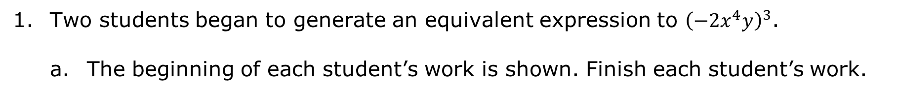
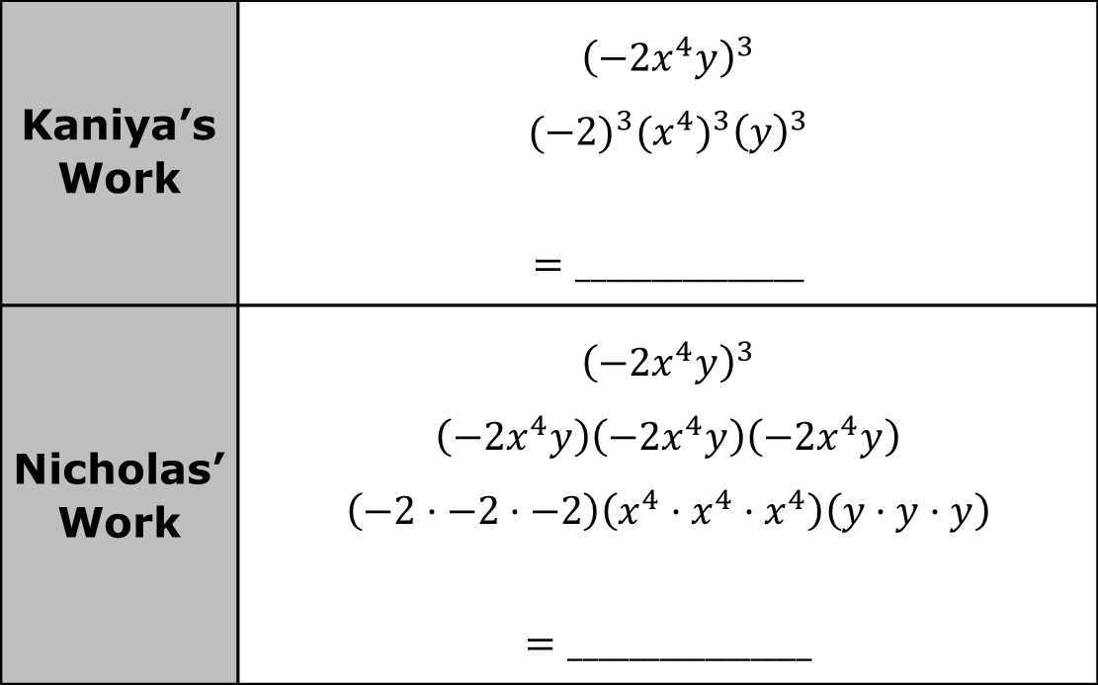
Two students began to generate an equivalent expression to ${\left(−2x^{4}y\right)}^{3}$.
The beginning of each student’s work is shown. Finish each student’s work.
Kaniya’s Work | $${\left(−2x^{4}y\right)}^{3}$$ $${(−2)}^{3}({x^{4})}^{3}{\left(y\right)}^{3}$$ $$=_______________$$
Nicholas’ Work | $${\left(−2x^{4}y\right)}^{3}$$ $$\left(−2x^{4}y\right)\left(−2x^{4}y\right)\left(−2x^{4}y\right)$$ $$\left(−2·−2·−2\right)\left(x^{4}·x^{4}·x^{4}\right)\left(y·y·y\right)$$ $$=________________$$
volume 1, pg. 59

Slide 18
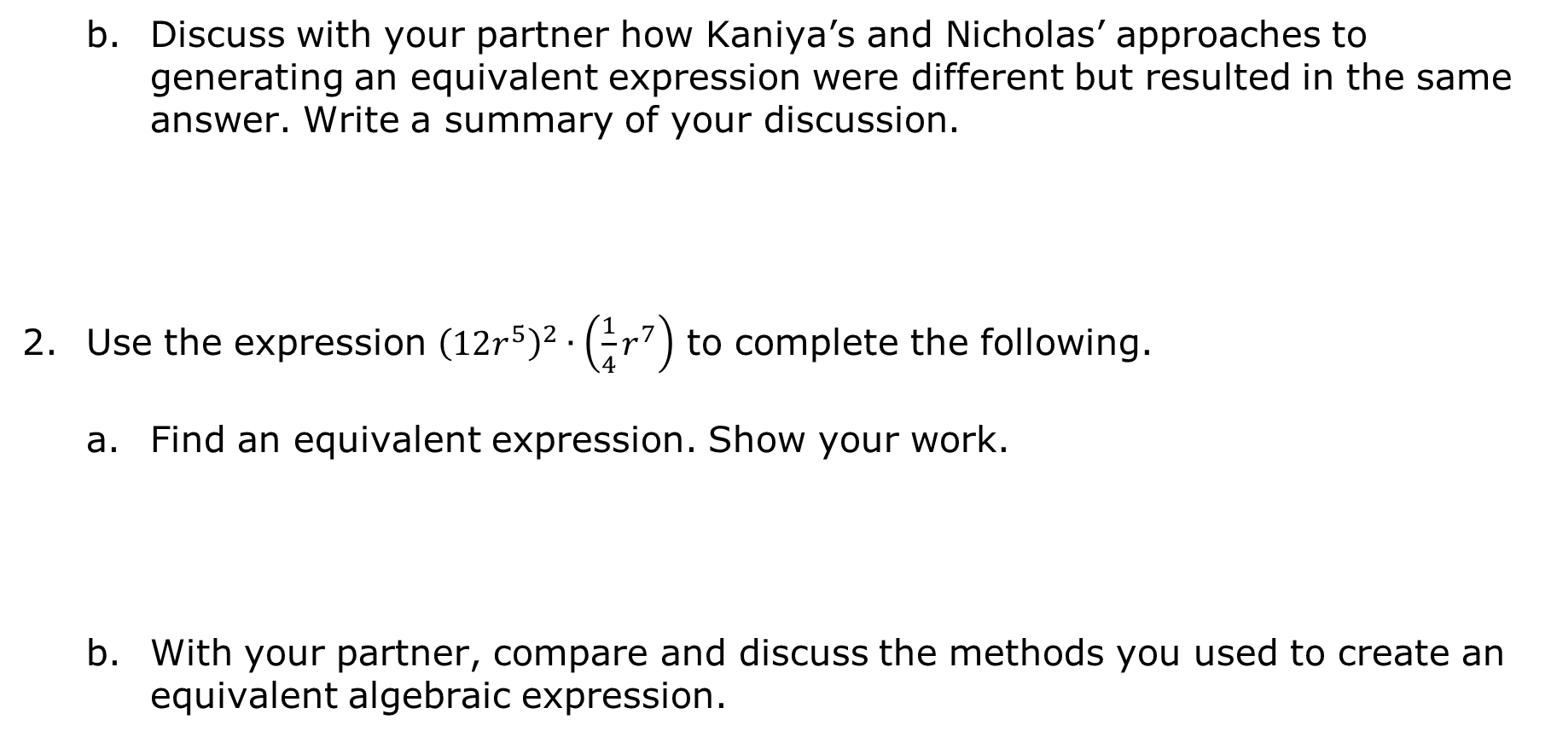
Discuss with your partner how Kaniya’s and Nicholas’ approaches to generating an equivalent expression were different but resulted in the same answer. Write a summary of your discussion.
Use the expression ${\left(12r^{5}\right)}^{2}∙\left(\frac{1}{4}r^{7}\right)$ to complete the following.
Find an equivalent expression. Show your work.
With your partner, compare and discuss the methods you used to create an equivalent algebraic expression.
volume 1, pg. 60

Slide 19

Your Turn
volume 1, pg. 60

Slide 20
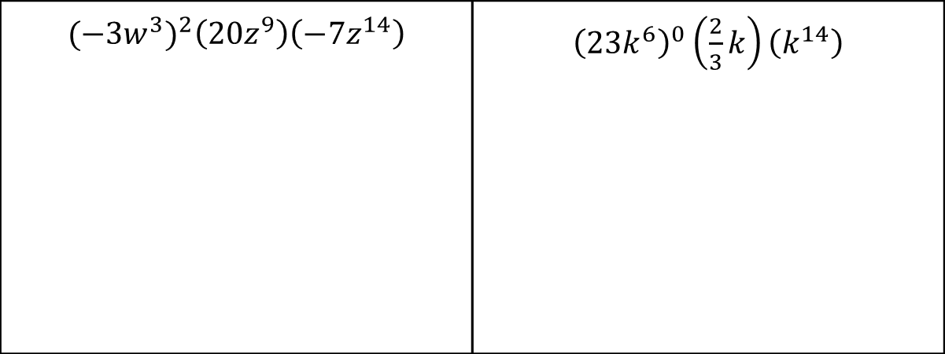
2.1.5 Your Turn!
Determine an equivalent monomial expression for each expression using the laws of exponents. Show your work.
$${{(−3w}^{3})}^{2}\left({20z}^{9}\right)\left(−7z^{14}\right)$$ | ${\left({23k}^{6}\right)}^{0}\left(\frac{2}{3}k\right)\left(k^{14}\right)$
volume 1, pg. 60

Slide 21
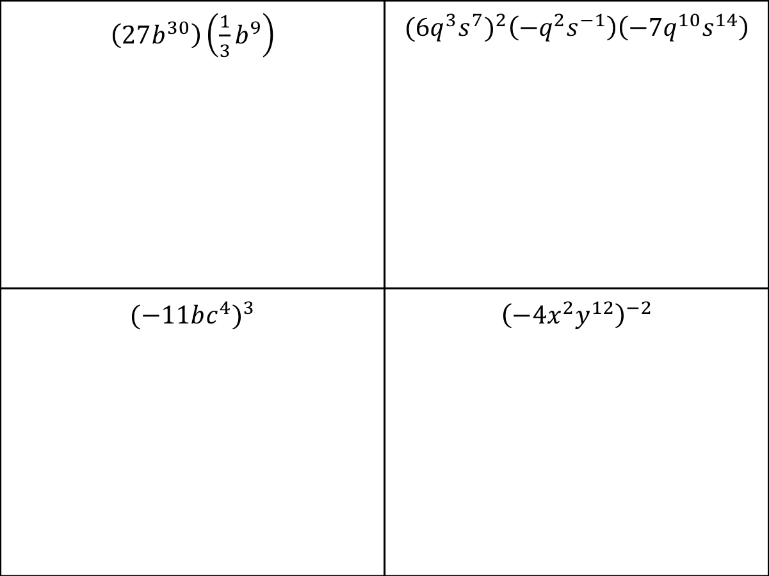
$\left(27b^{30}\right)\left({\frac{1}{3}b}^{9}\right)$ | $${{(6q}^{3}s^{7})}^{2}\left({−q}^{2}s^{−1}\right)\left(−7q^{10}s^{14}\right)$$
$${(−11bc^{4})}^{3}$$ | $${\left({−4x}^{2}y^{12}\right)}^{−2}$$
volume 1, pg. 60

Slide 22

Wrap-Up
volume 1, pg. 61

Slide 23
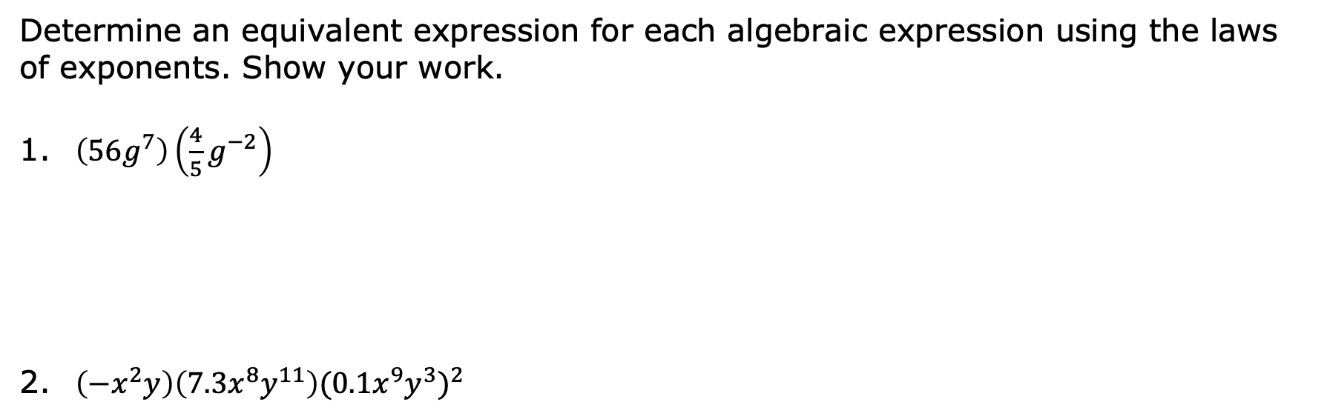
2.1.6 Wrap-Up: Cool Down
Determine an equivalent expression for each algebraic expression using the laws of exponents. Show your work.
1. $\left(56g^{7}\right)\left({\frac{4}{5}g}^{−2}\right)$
2. $\left({−x}^{2}y\right)\left(7.3x^{8}y^{11}\right){{(0.1x}^{9}y^{3})}^{2}$
volume 1, pg. 61

